Slide 1

From Nand to Tetris
Building a Modern Computer from First Principles
Chapter 6
Assembler
These slides support chapter 6 of the book
The Elements of Computing Systems
(1st and 2nd editions)
By Noam Nisan and Shimon Schocken
MIT Press

Slide 2
Usage Notice
You are welcome to use this presentation, or any part of it, in Nand to Tetris courses, or in other courses, as you see fit.
Usage is free provided that it supports instruction in educational, non-profit settings.
You can use the slides as-is, or modify them as needed.
We’ll appreciate it if you will credit Nand to Tetris somewhere, and put a reference to www.nand2tetris.org
Happy teaching!
Shimon Schocken / Noam Nisan

Slide 3
Nand to Tetris Roadmap (Part I: Hardware)
abstraction
Writing low-level programs
machine language
p4
Assembler: A program that translates symbolic machine language programs to binary code that can be executed by the computer
assembler
hardware platform
abstraction
Building a computer
computer
abstraction
Building chips
p5
ALU, RAM
abstraction
Building gates
p2
elementary logic gates
Nand
p3
p1

Slide 4
Nand to Tetris Roadmap (Part I: Hardware)
abstraction
Writing low-level programs
machine language
p4
Developing the assembler
This chapter
assembler
p6
hardware platform
abstraction
Building a computer
computer
abstraction
Building chips
p5
ALU, RAM
abstraction
Building gates
p2
elementary logic gates
Nand
p3
p1

Slide 5
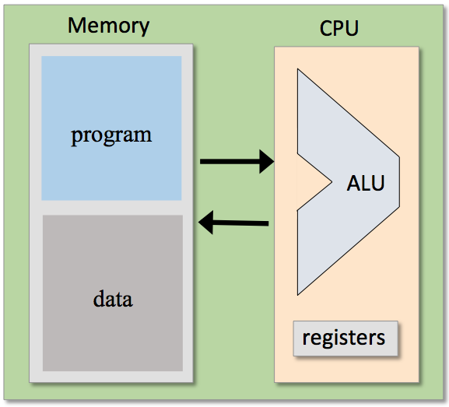
The assembler
Symbolic low-level program
Binary code
Computer
// Program: Sum1ToN (R0 represents N)
// Computes R1 = 1 + 2 + 3 + ... + R0
// Usage: put a value >= 1 in R0
// i = 1
@i
M=1
// sum = 0
@sum
M=0
(LOOP)
// if (i > R0) goto STOP
@i
D=M
@R0
D=D-M
@STOP
D;JGT
// sum = sum + i
@sum
D=M
@i
D=D+M
@sum
M=D
// i = i + 1
@i
M=M+1
// goto LOOP
@LOOP
0;JMP
...
0101111100111100
1010101010101010
1100000010101010
1011000010000001
0101111100111100
1010101010101010
1100000010101010
0101111100111100
1010101010101010
1100000010101010
1011000010000001
0101111100111100
1010101010101010
1100000010101010
0101111100111100
1010101010101010
1100000010101010
1011000010000001
0101111100111100
1010101010101010
1100000010101010
...
assembler
load and execute
Why write an assembler?
Because it is the “linchpin” that connects the hardware platform and the software hierarchy that sits on top of it
Because it provides a simple example of key software engineering techniques (parsing, code generation, symbol tables, …)

Slide 6
Chapter 6: Assembler
Overview
Translating instructions
Translating programs
Handling symbols
Assembler architecture
Assembler API
Project 6
Some history

Slide 7
Chapter 6: Assembler
Overview
Translating instructions
A-instructions
C-instructions
Translating programs
Handling symbols
Assembler architecture
Assembler API
Project 6
Some history

Slide 8
Translating A-instructions
Symbolic syntax:
Binary syntax:
translate
@xxx
0vvvvvvvvvvvvvvvv
Where xxx is a non-negative decimal value, or a symbol bound to such a value
Where:
0 is the A-instruction op-code, and
v v v … v is the value in binary
Example:
becomes
@17
0000000000010001
Implementation
Simple: Translate the decimal value into its 16-bit representation.

Slide 9
Translating C-instructions
Symbolic syntax:
dest = comp ; jump
Binary syntax:
1 1 1 a c c c c c c d d d j j j

Slide 10
Translating C-instructions
Symbolic syntax:
dest = comp ; jump
Binary syntax:
1 1 1 a c c c c c c d d d j j j
comp |  | c | c | c | c | c | c
0 |  | 1 | 0 | 1 | 0 | 1 | 0
1 |  | 1 | 1 | 1 | 1 | 1 | 1
-1 |  | 1 | 1 | 1 | 0 | 1 | 0
D |  | 0 | 0 | 1 | 1 | 0 | 0
A | M | 1 | 1 | 0 | 0 | 0 | 0
!D |  | 0 | 0 | 1 | 1 | 0 | 1
!A | !M | 1 | 1 | 0 | 0 | 0 | 1
-D |  | 0 | 0 | 1 | 1 | 1 | 1
-A | -M | 1 | 1 | 0 | 0 | 1 | 1
D+1 |  | 0 | 1 | 1 | 1 | 1 | 1
A+1 | M+1 | 1 | 1 | 0 | 1 | 1 | 1
D-1 |  | 0 | 0 | 1 | 1 | 1 | 0
A-1 | M-1 | 1 | 1 | 0 | 0 | 1 | 0
D+A | D+M | 0 | 0 | 0 | 0 | 1 | 0
D-A | D-M | 0 | 1 | 0 | 0 | 1 | 1
A-D | M-D | 0 | 0 | 0 | 1 | 1 | 1
D&A | D&M | 0 | 0 | 0 | 0 | 0 | 0
D|A | D|M | 0 | 1 | 0 | 1 | 0 | 1
a==0 | a==1
dest | d | d | d | effect: the value is stored in:
null | 0 | 0 | 0 | the value is not stored
M | 0 | 0 | 1 | RAM[A]
D | 0 | 1 | 0 | D register
DM | 0 | 1 | 1 | D register and RAM[A]
A | 1 | 0 | 0 | A register
AM | 1 | 0 | 1 | A register and RAM[A]
AD | 1 | 1 | 0 | A register and D register
ADM | 1 | 1 | 1 | A register, D register, and RAM[A]
jump | j | j | j | effect:
null | 0 | 0 | 0 | no jump
JGT | 0 | 0 | 1 | if comp > 0 jump
JEQ | 0 | 1 | 0 | if comp = 0 jump
JGE | 0 | 1 | 1 | if comp ≥ 0 jump
JLT | 1 | 0 | 0 | if comp < 0 jump
JNE | 1 | 0 | 1 | if comp ≠ 0 jump
JLE | 1 | 1 | 0 | if comp ≤ 0 jump
JMP | 1 | 1 | 1 | Unconditional jump
Implementation: Simple: Translate each field of the symbolic instruction (dest, comp, jump) into its binary code, and assemble the codes into a 16-bit instruction.

Slide 11
Translating C-instructions
Symbolic syntax:
dest = comp ; jump
Binary syntax:
1 1 1 a c c c c c c d d d j j j
comp |  | c | c | c | c | c | c
0 |  | 1 | 0 | 1 | 0 | 1 | 0
1 |  | 1 | 1 | 1 | 1 | 1 | 1
-1 |  | 1 | 1 | 1 | 0 | 1 | 0
D |  | 0 | 0 | 1 | 1 | 0 | 0
A | M | 1 | 1 | 0 | 0 | 0 | 0
!D |  | 0 | 0 | 1 | 1 | 0 | 1
!A | !M | 1 | 1 | 0 | 0 | 0 | 1
-D |  | 0 | 0 | 1 | 1 | 1 | 1
-A | -M | 1 | 1 | 0 | 0 | 1 | 1
D+1 |  | 0 | 1 | 1 | 1 | 1 | 1
A+1 | M+1 | 1 | 1 | 0 | 1 | 1 | 1
D-1 |  | 0 | 0 | 1 | 1 | 1 | 0
A-1 | M-1 | 1 | 1 | 0 | 0 | 1 | 0
D+A | D+M | 0 | 0 | 0 | 0 | 1 | 0
D-A | D-M | 0 | 1 | 0 | 0 | 1 | 1
A-D | M-D | 0 | 0 | 0 | 1 | 1 | 1
D&A | D&M | 0 | 0 | 0 | 0 | 0 | 0
D|A | D|M | 0 | 1 | 0 | 1 | 0 | 1
a==0 | a==1
dest | d | d | d | effect: the value is stored in:
null | 0 | 0 | 0 | the value is not stored
M | 0 | 0 | 1 | RAM[A]
D | 0 | 1 | 0 | D register
DM | 0 | 1 | 1 | D register and RAM[A]
A | 1 | 0 | 0 | A register
AM | 1 | 0 | 1 | A register and RAM[A]
AD | 1 | 1 | 0 | A register and D register
ADM | 1 | 1 | 1 | A register, D register, and RAM[A]
jump | j | j | j | effect:
null | 0 | 0 | 0 | no jump
JGT | 0 | 0 | 1 | if comp > 0 jump
JEQ | 0 | 1 | 0 | if comp = 0 jump
JGE | 0 | 1 | 1 | if comp ≥ 0 jump
JLT | 1 | 0 | 0 | if comp < 0 jump
JNE | 1 | 0 | 1 | if comp ≠ 0 jump
JLE | 1 | 1 | 0 | if comp ≤ 0 jump
JMP | 1 | 1 | 1 | Unconditional jump
Binary:
Example:
D=D+1;JLE

Slide 12
Translating C-instructions
Symbolic syntax:
dest = comp ; jump
Binary syntax:
1 1 1 a c c c c c c d d d j j j
comp |  | c | c | c | c | c | c
0 |  | 1 | 0 | 1 | 0 | 1 | 0
1 |  | 1 | 1 | 1 | 1 | 1 | 1
-1 |  | 1 | 1 | 1 | 0 | 1 | 0
D |  | 0 | 0 | 1 | 1 | 0 | 0
A | M | 1 | 1 | 0 | 0 | 0 | 0
!D |  | 0 | 0 | 1 | 1 | 0 | 1
!A | !M | 1 | 1 | 0 | 0 | 0 | 1
-D |  | 0 | 0 | 1 | 1 | 1 | 1
-A | -M | 1 | 1 | 0 | 0 | 1 | 1
D+1 |  | 0 | 1 | 1 | 1 | 1 | 1
A+1 | M+1 | 1 | 1 | 0 | 1 | 1 | 1
D-1 |  | 0 | 0 | 1 | 1 | 1 | 0
A-1 | M-1 | 1 | 1 | 0 | 0 | 1 | 0
D+A | D+M | 0 | 0 | 0 | 0 | 1 | 0
D-A | D-M | 0 | 1 | 0 | 0 | 1 | 1
A-D | M-D | 0 | 0 | 0 | 1 | 1 | 1
D&A | D&M | 0 | 0 | 0 | 0 | 0 | 0
D|A | D|M | 0 | 1 | 0 | 1 | 0 | 1
a==0 | a==1
dest | d | d | d | effect: the value is stored in:
null | 0 | 0 | 0 | the value is not stored
M | 0 | 0 | 1 | RAM[A]
D | 0 | 1 | 0 | D register
DM | 0 | 1 | 1 | D register and RAM[A]
A | 1 | 0 | 0 | A register
AM | 1 | 0 | 1 | A register and RAM[A]
AD | 1 | 1 | 0 | A register and D register
ADM | 1 | 1 | 1 | A register, D register, and RAM[A]
jump | j | j | j | effect:
null | 0 | 0 | 0 | no jump
JGT | 0 | 0 | 1 | if comp > 0 jump
JEQ | 0 | 1 | 0 | if comp = 0 jump
JGE | 0 | 1 | 1 | if comp ≥ 0 jump
JLT | 1 | 0 | 0 | if comp < 0 jump
JNE | 1 | 0 | 1 | if comp ≠ 0 jump
JLE | 1 | 1 | 0 | if comp ≤ 0 jump
JMP | 1 | 1 | 1 | Unconditional jump
Binary:
Example:
D=D+1;JLE
111

Slide 13
Translating C-instructions
Symbolic syntax:
dest = comp ; jump
Binary syntax:
1 1 1 a c c c c c c d d d j j j
comp |  | c | c | c | c | c | c
0 |  | 1 | 0 | 1 | 0 | 1 | 0
1 |  | 1 | 1 | 1 | 1 | 1 | 1
-1 |  | 1 | 1 | 1 | 0 | 1 | 0
D |  | 0 | 0 | 1 | 1 | 0 | 0
A | M | 1 | 1 | 0 | 0 | 0 | 0
!D |  | 0 | 0 | 1 | 1 | 0 | 1
!A | !M | 1 | 1 | 0 | 0 | 0 | 1
-D |  | 0 | 0 | 1 | 1 | 1 | 1
-A | -M | 1 | 1 | 0 | 0 | 1 | 1
D+1 |  | 0 | 1 | 1 | 1 | 1 | 1
A+1 | M+1 | 1 | 1 | 0 | 1 | 1 | 1
D-1 |  | 0 | 0 | 1 | 1 | 1 | 0
A-1 | M-1 | 1 | 1 | 0 | 0 | 1 | 0
D+A | D+M | 0 | 0 | 0 | 0 | 1 | 0
D-A | D-M | 0 | 1 | 0 | 0 | 1 | 1
A-D | M-D | 0 | 0 | 0 | 1 | 1 | 1
D&A | D&M | 0 | 0 | 0 | 0 | 0 | 0
D|A | D|M | 0 | 1 | 0 | 1 | 0 | 1
a==0 | a==1
dest | d | d | d | effect: the value is stored in:
null | 0 | 0 | 0 | the value is not stored
M | 0 | 0 | 1 | RAM[A]
D | 0 | 1 | 0 | D register
DM | 0 | 1 | 1 | D register and RAM[A]
A | 1 | 0 | 0 | A register
AM | 1 | 0 | 1 | A register and RAM[A]
AD | 1 | 1 | 0 | A register and D register
ADM | 1 | 1 | 1 | A register, D register, and RAM[A]
jump | j | j | j | effect:
null | 0 | 0 | 0 | no jump
JGT | 0 | 0 | 1 | if comp > 0 jump
JEQ | 0 | 1 | 0 | if comp = 0 jump
JGE | 0 | 1 | 1 | if comp ≥ 0 jump
JLT | 1 | 0 | 0 | if comp < 0 jump
JNE | 1 | 0 | 1 | if comp ≠ 0 jump
JLE | 1 | 1 | 0 | if comp ≤ 0 jump
JMP | 1 | 1 | 1 | Unconditional jump
Binary:
Example:
D=D+1;JLE
111

Slide 14
Translating C-instructions
Symbolic syntax:
dest = comp ; jump
Binary syntax:
1 1 1 a c c c c c c d d d j j j
comp |  | c | c | c | c | c | c
0 |  | 1 | 0 | 1 | 0 | 1 | 0
1 |  | 1 | 1 | 1 | 1 | 1 | 1
-1 |  | 1 | 1 | 1 | 0 | 1 | 0
D |  | 0 | 0 | 1 | 1 | 0 | 0
A | M | 1 | 1 | 0 | 0 | 0 | 0
!D |  | 0 | 0 | 1 | 1 | 0 | 1
!A | !M | 1 | 1 | 0 | 0 | 0 | 1
-D |  | 0 | 0 | 1 | 1 | 1 | 1
-A | -M | 1 | 1 | 0 | 0 | 1 | 1
D+1 |  | 0 | 1 | 1 | 1 | 1 | 1
A+1 | M+1 | 1 | 1 | 0 | 1 | 1 | 1
D-1 |  | 0 | 0 | 1 | 1 | 1 | 0
A-1 | M-1 | 1 | 1 | 0 | 0 | 1 | 0
D+A | D+M | 0 | 0 | 0 | 0 | 1 | 0
D-A | D-M | 0 | 1 | 0 | 0 | 1 | 1
A-D | M-D | 0 | 0 | 0 | 1 | 1 | 1
D&A | D&M | 0 | 0 | 0 | 0 | 0 | 0
D|A | D|M | 0 | 1 | 0 | 1 | 0 | 1
a==0 | a==1
dest | d | d | d | effect: the value is stored in:
null | 0 | 0 | 0 | the value is not stored
M | 0 | 0 | 1 | RAM[A]
D | 0 | 1 | 0 | D register
DM | 0 | 1 | 1 | D register and RAM[A]
A | 1 | 0 | 0 | A register
AM | 1 | 0 | 1 | A register and RAM[A]
AD | 1 | 1 | 0 | A register and D register
ADM | 1 | 1 | 1 | A register, D register, and RAM[A]
jump | j | j | j | effect:
null | 0 | 0 | 0 | no jump
JGT | 0 | 0 | 1 | if comp > 0 jump
JEQ | 0 | 1 | 0 | if comp = 0 jump
JGE | 0 | 1 | 1 | if comp ≥ 0 jump
JLT | 1 | 0 | 0 | if comp < 0 jump
JNE | 1 | 0 | 1 | if comp ≠ 0 jump
JLE | 1 | 1 | 0 | if comp ≤ 0 jump
JMP | 1 | 1 | 1 | Unconditional jump
Binary:
Example:
D=D+1;JLE
1110011111

Slide 15
Translating C-instructions
Symbolic syntax:
dest = comp ; jump
Binary syntax:
1 1 1 a c c c c c c d d d j j j
comp |  | c | c | c | c | c | c
0 |  | 1 | 0 | 1 | 0 | 1 | 0
1 |  | 1 | 1 | 1 | 1 | 1 | 1
-1 |  | 1 | 1 | 1 | 0 | 1 | 0
D |  | 0 | 0 | 1 | 1 | 0 | 0
A | M | 1 | 1 | 0 | 0 | 0 | 0
!D |  | 0 | 0 | 1 | 1 | 0 | 1
!A | !M | 1 | 1 | 0 | 0 | 0 | 1
-D |  | 0 | 0 | 1 | 1 | 1 | 1
-A | -M | 1 | 1 | 0 | 0 | 1 | 1
D+1 |  | 0 | 1 | 1 | 1 | 1 | 1
A+1 | M+1 | 1 | 1 | 0 | 1 | 1 | 1
D-1 |  | 0 | 0 | 1 | 1 | 1 | 0
A-1 | M-1 | 1 | 1 | 0 | 0 | 1 | 0
D+A | D+M | 0 | 0 | 0 | 0 | 1 | 0
D-A | D-M | 0 | 1 | 0 | 0 | 1 | 1
A-D | M-D | 0 | 0 | 0 | 1 | 1 | 1
D&A | D&M | 0 | 0 | 0 | 0 | 0 | 0
D|A | D|M | 0 | 1 | 0 | 1 | 0 | 1
a==0 | a==1
dest | d | d | d | effect: the value is stored in:
null | 0 | 0 | 0 | the value is not stored
M | 0 | 0 | 1 | RAM[A]
D | 0 | 1 | 0 | D register
DM | 0 | 1 | 1 | D register and RAM[A]
A | 1 | 0 | 0 | A register
AM | 1 | 0 | 1 | A register and RAM[A]
AD | 1 | 1 | 0 | A register and D register
ADM | 1 | 1 | 1 | A register, D register, and RAM[A]
jump | j | j | j | effect:
null | 0 | 0 | 0 | no jump
JGT | 0 | 0 | 1 | if comp > 0 jump
JEQ | 0 | 1 | 0 | if comp = 0 jump
JGE | 0 | 1 | 1 | if comp ≥ 0 jump
JLT | 1 | 0 | 0 | if comp < 0 jump
JNE | 1 | 0 | 1 | if comp ≠ 0 jump
JLE | 1 | 1 | 0 | if comp ≤ 0 jump
JMP | 1 | 1 | 1 | Unconditional jump
Binary:
Example:
D=D+1;JLE
1110011111

Slide 16
Translating C-instructions
Symbolic syntax:
dest = comp ; jump
Binary syntax:
1 1 1 a c c c c c c d d d j j j
comp |  | c | c | c | c | c | c
0 |  | 1 | 0 | 1 | 0 | 1 | 0
1 |  | 1 | 1 | 1 | 1 | 1 | 1
-1 |  | 1 | 1 | 1 | 0 | 1 | 0
D |  | 0 | 0 | 1 | 1 | 0 | 0
A | M | 1 | 1 | 0 | 0 | 0 | 0
!D |  | 0 | 0 | 1 | 1 | 0 | 1
!A | !M | 1 | 1 | 0 | 0 | 0 | 1
-D |  | 0 | 0 | 1 | 1 | 1 | 1
-A | -M | 1 | 1 | 0 | 0 | 1 | 1
D+1 |  | 0 | 1 | 1 | 1 | 1 | 1
A+1 | M+1 | 1 | 1 | 0 | 1 | 1 | 1
D-1 |  | 0 | 0 | 1 | 1 | 1 | 0
A-1 | M-1 | 1 | 1 | 0 | 0 | 1 | 0
D+A | D+M | 0 | 0 | 0 | 0 | 1 | 0
D-A | D-M | 0 | 1 | 0 | 0 | 1 | 1
A-D | M-D | 0 | 0 | 0 | 1 | 1 | 1
D&A | D&M | 0 | 0 | 0 | 0 | 0 | 0
D|A | D|M | 0 | 1 | 0 | 1 | 0 | 1
a==0 | a==1
dest | d | d | d | effect: the value is stored in:
null | 0 | 0 | 0 | the value is not stored
M | 0 | 0 | 1 | RAM[A]
D | 0 | 1 | 0 | D register
DM | 0 | 1 | 1 | D register and RAM[A]
A | 1 | 0 | 0 | A register
AM | 1 | 0 | 1 | A register and RAM[A]
AD | 1 | 1 | 0 | A register and D register
ADM | 1 | 1 | 1 | A register, D register, and RAM[A]
jump | j | j | j | effect:
null | 0 | 0 | 0 | no jump
JGT | 0 | 0 | 1 | if comp > 0 jump
JEQ | 0 | 1 | 0 | if comp = 0 jump
JGE | 0 | 1 | 1 | if comp ≥ 0 jump
JLT | 1 | 0 | 0 | if comp < 0 jump
JNE | 1 | 0 | 1 | if comp ≠ 0 jump
JLE | 1 | 1 | 0 | if comp ≤ 0 jump
JMP | 1 | 1 | 1 | Unconditional jump
Binary:
Example:
D=D+1;JLE
1110011111

Slide 17
Translating C-instructions
Symbolic syntax:
dest = comp ; jump
Binary syntax:
1 1 1 a c c c c c c d d d j j j
comp |  | c | c | c | c | c | c
0 |  | 1 | 0 | 1 | 0 | 1 | 0
1 |  | 1 | 1 | 1 | 1 | 1 | 1
-1 |  | 1 | 1 | 1 | 0 | 1 | 0
D |  | 0 | 0 | 1 | 1 | 0 | 0
A | M | 1 | 1 | 0 | 0 | 0 | 0
!D |  | 0 | 0 | 1 | 1 | 0 | 1
!A | !M | 1 | 1 | 0 | 0 | 0 | 1
-D |  | 0 | 0 | 1 | 1 | 1 | 1
-A | -M | 1 | 1 | 0 | 0 | 1 | 1
D+1 |  | 0 | 1 | 1 | 1 | 1 | 1
A+1 | M+1 | 1 | 1 | 0 | 1 | 1 | 1
D-1 |  | 0 | 0 | 1 | 1 | 1 | 0
A-1 | M-1 | 1 | 1 | 0 | 0 | 1 | 0
D+A | D+M | 0 | 0 | 0 | 0 | 1 | 0
D-A | D-M | 0 | 1 | 0 | 0 | 1 | 1
A-D | M-D | 0 | 0 | 0 | 1 | 1 | 1
D&A | D&M | 0 | 0 | 0 | 0 | 0 | 0
D|A | D|M | 0 | 1 | 0 | 1 | 0 | 1
a==0 | a==1
dest | d | d | d | effect: the value is stored in:
null | 0 | 0 | 0 | the value is not stored
M | 0 | 0 | 1 | RAM[A]
D | 0 | 1 | 0 | D register
DM | 0 | 1 | 1 | D register and RAM[A]
A | 1 | 0 | 0 | A register
AM | 1 | 0 | 1 | A register and RAM[A]
AD | 1 | 1 | 0 | A register and D register
ADM | 1 | 1 | 1 | A register, D register, and RAM[A]
jump | j | j | j | effect:
null | 0 | 0 | 0 | no jump
JGT | 0 | 0 | 1 | if comp > 0 jump
JEQ | 0 | 1 | 0 | if comp = 0 jump
JGE | 0 | 1 | 1 | if comp ≥ 0 jump
JLT | 1 | 0 | 0 | if comp < 0 jump
JNE | 1 | 0 | 1 | if comp ≠ 0 jump
JLE | 1 | 1 | 0 | if comp ≤ 0 jump
JMP | 1 | 1 | 1 | Unconditional jump
Binary:
Example:
D=D+1;JLE
1110011111010

Slide 18
Translating C-instructions
Symbolic syntax:
dest = comp ; jump
Binary syntax:
1 1 1 a c c c c c c d d d j j j
comp |  | c | c | c | c | c | c
0 |  | 1 | 0 | 1 | 0 | 1 | 0
1 |  | 1 | 1 | 1 | 1 | 1 | 1
-1 |  | 1 | 1 | 1 | 0 | 1 | 0
D |  | 0 | 0 | 1 | 1 | 0 | 0
A | M | 1 | 1 | 0 | 0 | 0 | 0
!D |  | 0 | 0 | 1 | 1 | 0 | 1
!A | !M | 1 | 1 | 0 | 0 | 0 | 1
-D |  | 0 | 0 | 1 | 1 | 1 | 1
-A | -M | 1 | 1 | 0 | 0 | 1 | 1
D+1 |  | 0 | 1 | 1 | 1 | 1 | 1
A+1 | M+1 | 1 | 1 | 0 | 1 | 1 | 1
D-1 |  | 0 | 0 | 1 | 1 | 1 | 0
A-1 | M-1 | 1 | 1 | 0 | 0 | 1 | 0
D+A | D+M | 0 | 0 | 0 | 0 | 1 | 0
D-A | D-M | 0 | 1 | 0 | 0 | 1 | 1
A-D | M-D | 0 | 0 | 0 | 1 | 1 | 1
D&A | D&M | 0 | 0 | 0 | 0 | 0 | 0
D|A | D|M | 0 | 1 | 0 | 1 | 0 | 1
a==0 | a==1
dest | d | d | d | effect: the value is stored in:
null | 0 | 0 | 0 | the value is not stored
M | 0 | 0 | 1 | RAM[A]
D | 0 | 1 | 0 | D register
DM | 0 | 1 | 1 | D register and RAM[A]
A | 1 | 0 | 0 | A register
AM | 1 | 0 | 1 | A register and RAM[A]
AD | 1 | 1 | 0 | A register and D register
ADM | 1 | 1 | 1 | A register, D register, and RAM[A]
jump | j | j | j | effect:
null | 0 | 0 | 0 | no jump
JGT | 0 | 0 | 1 | if comp > 0 jump
JEQ | 0 | 1 | 0 | if comp = 0 jump
JGE | 0 | 1 | 1 | if comp ≥ 0 jump
JLT | 1 | 0 | 0 | if comp < 0 jump
JNE | 1 | 0 | 1 | if comp ≠ 0 jump
JLE | 1 | 1 | 0 | if comp ≤ 0 jump
JMP | 1 | 1 | 1 | Unconditional jump
Binary:
Example:
D=D+1;JLE
1110011111010

Slide 19
Translating C-instructions
Symbolic syntax:
dest = comp ; jump
Binary syntax:
1 1 1 a c c c c c c d d d j j j
comp |  | c | c | c | c | c | c
0 |  | 1 | 0 | 1 | 0 | 1 | 0
1 |  | 1 | 1 | 1 | 1 | 1 | 1
-1 |  | 1 | 1 | 1 | 0 | 1 | 0
D |  | 0 | 0 | 1 | 1 | 0 | 0
A | M | 1 | 1 | 0 | 0 | 0 | 0
!D |  | 0 | 0 | 1 | 1 | 0 | 1
!A | !M | 1 | 1 | 0 | 0 | 0 | 1
-D |  | 0 | 0 | 1 | 1 | 1 | 1
-A | -M | 1 | 1 | 0 | 0 | 1 | 1
D+1 |  | 0 | 1 | 1 | 1 | 1 | 1
A+1 | M+1 | 1 | 1 | 0 | 1 | 1 | 1
D-1 |  | 0 | 0 | 1 | 1 | 1 | 0
A-1 | M-1 | 1 | 1 | 0 | 0 | 1 | 0
D+A | D+M | 0 | 0 | 0 | 0 | 1 | 0
D-A | D-M | 0 | 1 | 0 | 0 | 1 | 1
A-D | M-D | 0 | 0 | 0 | 1 | 1 | 1
D&A | D&M | 0 | 0 | 0 | 0 | 0 | 0
D|A | D|M | 0 | 1 | 0 | 1 | 0 | 1
a==0 | a==1
dest | d | d | d | effect: the value is stored in:
null | 0 | 0 | 0 | the value is not stored
M | 0 | 0 | 1 | RAM[A]
D | 0 | 1 | 0 | D register
DM | 0 | 1 | 1 | D register and RAM[A]
A | 1 | 0 | 0 | A register
AM | 1 | 0 | 1 | A register and RAM[A]
AD | 1 | 1 | 0 | A register and D register
ADM | 1 | 1 | 1 | A register, D register, and RAM[A]
jump | j | j | j | effect:
null | 0 | 0 | 0 | no jump
JGT | 0 | 0 | 1 | if comp > 0 jump
JEQ | 0 | 1 | 0 | if comp = 0 jump
JGE | 0 | 1 | 1 | if comp ≥ 0 jump
JLT | 1 | 0 | 0 | if comp < 0 jump
JNE | 1 | 0 | 1 | if comp ≠ 0 jump
JLE | 1 | 1 | 0 | if comp ≤ 0 jump
JMP | 1 | 1 | 1 | Unconditional jump
Binary:
Example:
D=D+1;JLE
1110011111010

Slide 20
Translating C-instructions
Symbolic syntax:
dest = comp ; jump
Binary syntax:
1 1 1 a c c c c c c d d d j j j
comp |  | c | c | c | c | c | c
0 |  | 1 | 0 | 1 | 0 | 1 | 0
1 |  | 1 | 1 | 1 | 1 | 1 | 1
-1 |  | 1 | 1 | 1 | 0 | 1 | 0
D |  | 0 | 0 | 1 | 1 | 0 | 0
A | M | 1 | 1 | 0 | 0 | 0 | 0
!D |  | 0 | 0 | 1 | 1 | 0 | 1
!A | !M | 1 | 1 | 0 | 0 | 0 | 1
-D |  | 0 | 0 | 1 | 1 | 1 | 1
-A | -M | 1 | 1 | 0 | 0 | 1 | 1
D+1 |  | 0 | 1 | 1 | 1 | 1 | 1
A+1 | M+1 | 1 | 1 | 0 | 1 | 1 | 1
D-1 |  | 0 | 0 | 1 | 1 | 1 | 0
A-1 | M-1 | 1 | 1 | 0 | 0 | 1 | 0
D+A | D+M | 0 | 0 | 0 | 0 | 1 | 0
D-A | D-M | 0 | 1 | 0 | 0 | 1 | 1
A-D | M-D | 0 | 0 | 0 | 1 | 1 | 1
D&A | D&M | 0 | 0 | 0 | 0 | 0 | 0
D|A | D|M | 0 | 1 | 0 | 1 | 0 | 1
a==0 | a==1
dest | d | d | d | effect: the value is stored in:
null | 0 | 0 | 0 | the value is not stored
M | 0 | 0 | 1 | RAM[A]
D | 0 | 1 | 0 | D register
DM | 0 | 1 | 1 | D register and RAM[A]
A | 1 | 0 | 0 | A register
AM | 1 | 0 | 1 | A register and RAM[A]
AD | 1 | 1 | 0 | A register and D register
ADM | 1 | 1 | 1 | A register, D register, and RAM[A]
jump | j | j | j | effect:
null | 0 | 0 | 0 | no jump
JGT | 0 | 0 | 1 | if comp > 0 jump
JEQ | 0 | 1 | 0 | if comp = 0 jump
JGE | 0 | 1 | 1 | if comp ≥ 0 jump
JLT | 1 | 0 | 0 | if comp < 0 jump
JNE | 1 | 0 | 1 | if comp ≠ 0 jump
JLE | 1 | 1 | 0 | if comp ≤ 0 jump
JMP | 1 | 1 | 1 | Unconditional jump
Binary:
Example:
D=D+1;JLE
1110011111010110

Slide 21

Translating C-instructions
Symbolic syntax:
dest = comp ; jump
Binary syntax:
1 1 1 a c c c c c c d d d j j j
comp |  | c | c | c | c | c | c
0 |  | 1 | 0 | 1 | 0 | 1 | 0
1 |  | 1 | 1 | 1 | 1 | 1 | 1
-1 |  | 1 | 1 | 1 | 0 | 1 | 0
D |  | 0 | 0 | 1 | 1 | 0 | 0
A | M | 1 | 1 | 0 | 0 | 0 | 0
!D |  | 0 | 0 | 1 | 1 | 0 | 1
!A | !M | 1 | 1 | 0 | 0 | 0 | 1
-D |  | 0 | 0 | 1 | 1 | 1 | 1
-A | -M | 1 | 1 | 0 | 0 | 1 | 1
D+1 |  | 0 | 1 | 1 | 1 | 1 | 1
A+1 | M+1 | 1 | 1 | 0 | 1 | 1 | 1
D-1 |  | 0 | 0 | 1 | 1 | 1 | 0
A-1 | M-1 | 1 | 1 | 0 | 0 | 1 | 0
D+A | D+M | 0 | 0 | 0 | 0 | 1 | 0
D-A | D-M | 0 | 1 | 0 | 0 | 1 | 1
A-D | M-D | 0 | 0 | 0 | 1 | 1 | 1
D&A | D&M | 0 | 0 | 0 | 0 | 0 | 0
D|A | D|M | 0 | 1 | 0 | 1 | 0 | 1
a==0 | a==1
dest | d | d | d | effect: the value is stored in:
null | 0 | 0 | 0 | the value is not stored
M | 0 | 0 | 1 | RAM[A]
D | 0 | 1 | 0 | D register
DM | 0 | 1 | 1 | D register and RAM[A]
A | 1 | 0 | 0 | A register
AM | 1 | 0 | 1 | A register and RAM[A]
AD | 1 | 1 | 0 | A register and D register
ADM | 1 | 1 | 1 | A register, D register, and RAM[A]
jump | j | j | j | effect:
null | 0 | 0 | 0 | no jump
JGT | 0 | 0 | 1 | if comp > 0 jump
JEQ | 0 | 1 | 0 | if comp = 0 jump
JGE | 0 | 1 | 1 | if comp ≥ 0 jump
JLT | 1 | 0 | 0 | if comp < 0 jump
JNE | 1 | 0 | 1 | if comp ≠ 0 jump
JLE | 1 | 1 | 0 | if comp ≤ 0 jump
JMP | 1 | 1 | 1 | Unconditional jump
Binary:
Example:
D=D+1;JLE
1110011111010110

Slide 22
Translating C-instructions
Symbolic syntax:
dest = comp ; jump
Binary syntax:
1 1 1 a c c c c c c d d d j j j
comp |  | c | c | c | c | c | c
0 |  | 1 | 0 | 1 | 0 | 1 | 0
1 |  | 1 | 1 | 1 | 1 | 1 | 1
-1 |  | 1 | 1 | 1 | 0 | 1 | 0
D |  | 0 | 0 | 1 | 1 | 0 | 0
A | M | 1 | 1 | 0 | 0 | 0 | 0
!D |  | 0 | 0 | 1 | 1 | 0 | 1
!A | !M | 1 | 1 | 0 | 0 | 0 | 1
-D |  | 0 | 0 | 1 | 1 | 1 | 1
-A | -M | 1 | 1 | 0 | 0 | 1 | 1
D+1 |  | 0 | 1 | 1 | 1 | 1 | 1
A+1 | M+1 | 1 | 1 | 0 | 1 | 1 | 1
D-1 |  | 0 | 0 | 1 | 1 | 1 | 0
A-1 | M-1 | 1 | 1 | 0 | 0 | 1 | 0
D+A | D+M | 0 | 0 | 0 | 0 | 1 | 0
D-A | D-M | 0 | 1 | 0 | 0 | 1 | 1
A-D | M-D | 0 | 0 | 0 | 1 | 1 | 1
D&A | D&M | 0 | 0 | 0 | 0 | 0 | 0
D|A | D|M | 0 | 1 | 0 | 1 | 0 | 1
a==0 | a==1
dest | d | d | d | effect: the value is stored in:
null | 0 | 0 | 0 | the value is not stored
M | 0 | 0 | 1 | RAM[A]
D | 0 | 1 | 0 | D register
DM | 0 | 1 | 1 | D register and RAM[A]
A | 1 | 0 | 0 | A register
AM | 1 | 0 | 1 | A register and RAM[A]
AD | 1 | 1 | 0 | A register and D register
ADM | 1 | 1 | 1 | A register, D register, and RAM[A]
jump | j | j | j | effect:
null | 0 | 0 | 0 | no jump
JGT | 0 | 0 | 1 | if comp > 0 jump
JEQ | 0 | 1 | 0 | if comp = 0 jump
JGE | 0 | 1 | 1 | if comp ≥ 0 jump
JLT | 1 | 0 | 0 | if comp < 0 jump
JNE | 1 | 0 | 1 | if comp ≠ 0 jump
JLE | 1 | 1 | 0 | if comp ≤ 0 jump
JMP | 1 | 1 | 1 | Unconditional jump
Binary:
Example:
A=-1

Slide 23
Translating C-instructions
Symbolic syntax:
dest = comp ; jump
Binary syntax:
1 1 1 a c c c c c c d d d j j j
comp |  | c | c | c | c | c | c
0 |  | 1 | 0 | 1 | 0 | 1 | 0
1 |  | 1 | 1 | 1 | 1 | 1 | 1
-1 |  | 1 | 1 | 1 | 0 | 1 | 0
D |  | 0 | 0 | 1 | 1 | 0 | 0
A | M | 1 | 1 | 0 | 0 | 0 | 0
!D |  | 0 | 0 | 1 | 1 | 0 | 1
!A | !M | 1 | 1 | 0 | 0 | 0 | 1
-D |  | 0 | 0 | 1 | 1 | 1 | 1
-A | -M | 1 | 1 | 0 | 0 | 1 | 1
D+1 |  | 0 | 1 | 1 | 1 | 1 | 1
A+1 | M+1 | 1 | 1 | 0 | 1 | 1 | 1
D-1 |  | 0 | 0 | 1 | 1 | 1 | 0
A-1 | M-1 | 1 | 1 | 0 | 0 | 1 | 0
D+A | D+M | 0 | 0 | 0 | 0 | 1 | 0
D-A | D-M | 0 | 1 | 0 | 0 | 1 | 1
A-D | M-D | 0 | 0 | 0 | 1 | 1 | 1
D&A | D&M | 0 | 0 | 0 | 0 | 0 | 0
D|A | D|M | 0 | 1 | 0 | 1 | 0 | 1
a==0 | a==1
dest | d | d | d | effect: the value is stored in:
null | 0 | 0 | 0 | the value is not stored
M | 0 | 0 | 1 | RAM[A]
D | 0 | 1 | 0 | D register
DM | 0 | 1 | 1 | D register and RAM[A]
A | 1 | 0 | 0 | A register
AM | 1 | 0 | 1 | A register and RAM[A]
AD | 1 | 1 | 0 | A register and D register
ADM | 1 | 1 | 1 | A register, D register, and RAM[A]
jump | j | j | j | effect:
null | 0 | 0 | 0 | no jump
JGT | 0 | 0 | 1 | if comp > 0 jump
JEQ | 0 | 1 | 0 | if comp = 0 jump
JGE | 0 | 1 | 1 | if comp ≥ 0 jump
JLT | 1 | 0 | 0 | if comp < 0 jump
JNE | 1 | 0 | 1 | if comp ≠ 0 jump
JLE | 1 | 1 | 0 | if comp ≤ 0 jump
JMP | 1 | 1 | 1 | Unconditional jump
Binary:
Example:
A=-1
111

Slide 24
Translating C-instructions
Symbolic syntax:
dest = comp ; jump
Binary syntax:
1 1 1 a c c c c c c d d d j j j
comp |  | c | c | c | c | c | c
0 |  | 1 | 0 | 1 | 0 | 1 | 0
1 |  | 1 | 1 | 1 | 1 | 1 | 1
-1 |  | 1 | 1 | 1 | 0 | 1 | 0
D |  | 0 | 0 | 1 | 1 | 0 | 0
A | M | 1 | 1 | 0 | 0 | 0 | 0
!D |  | 0 | 0 | 1 | 1 | 0 | 1
!A | !M | 1 | 1 | 0 | 0 | 0 | 1
-D |  | 0 | 0 | 1 | 1 | 1 | 1
-A | -M | 1 | 1 | 0 | 0 | 1 | 1
D+1 |  | 0 | 1 | 1 | 1 | 1 | 1
A+1 | M+1 | 1 | 1 | 0 | 1 | 1 | 1
D-1 |  | 0 | 0 | 1 | 1 | 1 | 0
A-1 | M-1 | 1 | 1 | 0 | 0 | 1 | 0
D+A | D+M | 0 | 0 | 0 | 0 | 1 | 0
D-A | D-M | 0 | 1 | 0 | 0 | 1 | 1
A-D | M-D | 0 | 0 | 0 | 1 | 1 | 1
D&A | D&M | 0 | 0 | 0 | 0 | 0 | 0
D|A | D|M | 0 | 1 | 0 | 1 | 0 | 1
a==0 | a==1
dest | d | d | d | effect: the value is stored in:
null | 0 | 0 | 0 | the value is not stored
M | 0 | 0 | 1 | RAM[A]
D | 0 | 1 | 0 | D register
DM | 0 | 1 | 1 | D register and RAM[A]
A | 1 | 0 | 0 | A register
AM | 1 | 0 | 1 | A register and RAM[A]
AD | 1 | 1 | 0 | A register and D register
ADM | 1 | 1 | 1 | A register, D register, and RAM[A]
jump | j | j | j | effect:
null | 0 | 0 | 0 | no jump
JGT | 0 | 0 | 1 | if comp > 0 jump
JEQ | 0 | 1 | 0 | if comp = 0 jump
JGE | 0 | 1 | 1 | if comp ≥ 0 jump
JLT | 1 | 0 | 0 | if comp < 0 jump
JNE | 1 | 0 | 1 | if comp ≠ 0 jump
JLE | 1 | 1 | 0 | if comp ≤ 0 jump
JMP | 1 | 1 | 1 | Unconditional jump
Binary:
Example:
A=-1
111

Slide 25
Translating C-instructions
Symbolic syntax:
dest = comp ; jump
Binary syntax:
1 1 1 a c c c c c c d d d j j j
comp |  | c | c | c | c | c | c
0 |  | 1 | 0 | 1 | 0 | 1 | 0
1 |  | 1 | 1 | 1 | 1 | 1 | 1
-1 |  | 1 | 1 | 1 | 0 | 1 | 0
D |  | 0 | 0 | 1 | 1 | 0 | 0
A | M | 1 | 1 | 0 | 0 | 0 | 0
!D |  | 0 | 0 | 1 | 1 | 0 | 1
!A | !M | 1 | 1 | 0 | 0 | 0 | 1
-D |  | 0 | 0 | 1 | 1 | 1 | 1
-A | -M | 1 | 1 | 0 | 0 | 1 | 1
D+1 |  | 0 | 1 | 1 | 1 | 1 | 1
A+1 | M+1 | 1 | 1 | 0 | 1 | 1 | 1
D-1 |  | 0 | 0 | 1 | 1 | 1 | 0
A-1 | M-1 | 1 | 1 | 0 | 0 | 1 | 0
D+A | D+M | 0 | 0 | 0 | 0 | 1 | 0
D-A | D-M | 0 | 1 | 0 | 0 | 1 | 1
A-D | M-D | 0 | 0 | 0 | 1 | 1 | 1
D&A | D&M | 0 | 0 | 0 | 0 | 0 | 0
D|A | D|M | 0 | 1 | 0 | 1 | 0 | 1
a==0 | a==1
dest | d | d | d | effect: the value is stored in:
null | 0 | 0 | 0 | the value is not stored
M | 0 | 0 | 1 | RAM[A]
D | 0 | 1 | 0 | D register
DM | 0 | 1 | 1 | D register and RAM[A]
A | 1 | 0 | 0 | A register
AM | 1 | 0 | 1 | A register and RAM[A]
AD | 1 | 1 | 0 | A register and D register
ADM | 1 | 1 | 1 | A register, D register, and RAM[A]
jump | j | j | j | effect:
null | 0 | 0 | 0 | no jump
JGT | 0 | 0 | 1 | if comp > 0 jump
JEQ | 0 | 1 | 0 | if comp = 0 jump
JGE | 0 | 1 | 1 | if comp ≥ 0 jump
JLT | 1 | 0 | 0 | if comp < 0 jump
JNE | 1 | 0 | 1 | if comp ≠ 0 jump
JLE | 1 | 1 | 0 | if comp ≤ 0 jump
JMP | 1 | 1 | 1 | Unconditional jump
Binary:
Example:
A=-1
1110111010100000

Slide 26
Chapter 6: Assembler
Overview
Translating instructions
Translating programs
Handling symbols
Assembler architecture
Assembler API
Project 6
Some history

Slide 27
Program translation
Symbolic code
Binary code
// Computes R1=1 + ... + R0
// i = 1
@i
M=1
// sum = 0
@sum
M=0
(LOOP)
// if i>R0 goto STOP
@i
D=M
@R0
D=D-M
@STOP
D;JGT
// sum += i
@i
D=M
@sum
M=D+M
// i++
@i
M=M+1
@LOOP
0;JMP
(STOP)
@sum
D=M
...
Translate
0000000000010000
1110111111001000
0000000000010001
1110101010001000
0000000000010000
1111110000010000
0000000000000000
1111010011010000
0000000000010010
1110001100000001
0000000000010000
1111110000010000
0000000000010001
1111000010001000
0000000000010000
1111110111001000
0000000000000100
1110101010000111
0000000000010001
1111110000010000
...
Need to handle:
White space
Instructions
Symbols
We’ll start with programs that have no symbols,
and handle symbols later

Slide 28
Program translation
Symbolic code
Binary code
// Computes R1=1 + ... + R0
// i = 1
@16
M=1
// sum = 0
@17
M=0
// if i>R0 goto STOP
@16
D=M
@0
D=D-M
@18
D;JGT
// sum += i
@16
D=M
@17
M=D+M
// i++
@16
M=M+1
@4
0;JMP
@17
D=M
...
Translate
Need to handle:
White space
Instructions
Symbols (later)
no symbols

Slide 29
Program translation
Symbolic code
Binary code
// Computes R1=1 + ... + R0
// i = 1
@16
M=1
// sum = 0
@17
M=0
// if i>R0 goto STOP
@16
D=M
@0
D=D-M
@18
D;JGT
// sum += i
@16
D=M
@17
M=D+M
// i++
@16
M=M+1
@4
0;JMP
@17
D=M
...
Translate
Need to handle:
White space
Instructions
Symbols (later)
no symbols

Slide 30
Program translation
Symbolic code
Binary code
// Computes R1=1 + ... + R0
// i = 1
@16
M=1
// sum = 0
@17
M=0
// if i>R0 goto STOP
@16
D=M
@0
D=D-M
@18
D;JGT
// sum += i
@16
D=M
@17
M=D+M
// i++
@16
M=M+1
@4
0;JMP
@17
D=M
...
Translate
Need to handle:
White space
Instructions
Symbols (later)
Ignore it
White space:
Empty lines,
Comments,
Indentation
no symbols

Slide 31
Program translation
Symbolic code
Binary code
@16
M=1
@17
M=0
@16
D=M
@0
D=D-M
@18
D;JGT
@16
D=M
@17
M=D+M
@16
M=M+1
@4
0;JMP
@17
D=M
...
Translate
Need to handle:
White space
Instructions
Symbols (later)
no symbols

Slide 32
Program translation
Symbolic code
Binary code
@16
M=1
@17
M=0
@16
D=M
@0
D=D-M
@18
D;JGT
@16
D=M
@17
M=D+M
@16
M=M+1
@4
0;JMP
@17
D=M
...
Translate
Need to handle:
White space
Instructions
Symbols (later)
Translate, one by one
no symbols

Slide 33
Program translation
Symbolic code
Binary code
@16
M=1
@17
M=0
@16
D=M
@0
D=D-M
@18
D;JGT
@16
D=M
@17
M=D+M
@16
M=M+1
@4
0;JMP
@17
D=M
...
Translate
0000000000010000
1110111111001000
0000000000010001
1110101010001000
0000000000010000
1111110000010000
0000000000000000
1111010011010000
0000000000010010
1110001100000001
0000000000010000
1111110000010000
0000000000010001
1111000010001000
0000000000010000
1111110111001000
0000000000000100
1110101010000111
0000000000010001
1111110000010000
...
Need to handle:
White space
Instructions
Symbols (later)
Translate, one by one
no symbols

Slide 34
Program translation
Symbolic code
Binary code
@16
M=1
@17
M=0
@16
D=M
@0
D=D-M
@18
D;JGT
@16
D=M
@17
M=D+M
@16
M=M+1
@4
0;JMP
@17
D=M
...
Translate
0000000000010000
1110111111001000
0000000000010001
1110101010001000
0000000000010000
1111110000010000
0000000000000000
1111010011010000
0000000000010010
1110001100000001
0000000000010000
1111110000010000
0000000000010001
1111000010001000
0000000000010000
1111110111001000
0000000000000100
1110101010000111
0000000000010001
1111110000010000
...
Need to handle:
White space
Instructions
Symbols
no symbols

Slide 35
Program translation
Symbolic code
Binary code
@16
M=1
@17
M=0
@16
D=M
@0
D=D-M
@18
D;JGT
@16
D=M
@17
M=D+M
@16
M=M+1
@4
0;JMP
@17
D=M
...
Translate
0000000000010000
1110111111001000
0000000000010001
1110101010001000
0000000000010000
1111110000010000
0000000000000000
1111010011010000
0000000000010010
1110001100000001
0000000000010000
1111110000010000
0000000000010001
1111000010001000
0000000000010000
1111110111001000
0000000000000100
1110101010000111
0000000000010001
1111110000010000
...
Need to handle:
White space
Instructions
Symbols
no symbols

Slide 36
Program translation
Symbolic code
Binary code
// Computes R1=1 + ... + R0
// i = 1
@i
M=1
// sum = 0
@sum
M=0
(LOOP)
// if i>R0 goto STOP
@i
D=M
@R0
D=D-M
@STOP
D;JGT
// sum += i
@i
D=M
@sum
M=D+M
// i++
@i
M=M+1
@LOOP
0;JMP
(STOP)
@sum
D=M
...
Translate
Need to handle:
White space
Instructions
Symbols
Original program, with symbols
no symbols

Slide 37
Handling symbols
Symbolic code
Symbolic code
// Computes R1=1 + ... + R0
// i = 1
@i
M=1
// sum = 0
@sum
M=0
(LOOP)
// if i>R0 goto STOP
@i
D=M
@R0
D=D-M
@STOP
D;JGT
// sum += i
@i
D=M
@sum
M=D+M
// i++
@i
M=M+1
@LOOP
0;JMP
(STOP)
@sum
D=M
...
Symbols
Predefined symbols
Label symbols
Variable symbols
Original program, with symbols

Slide 38
Handling symbols
Symbolic code
Symbolic code
// Computes R1=1 + ... + R0
// i = 1
@i
M=1
// sum = 0
@sum
M=0
(LOOP)
// if i>R0 goto STOP
@i
D=M
@R0
D=D-M
@STOP
D;JGT
// sum += i
@i
D=M
@sum
M=D+M
// i++
@i
M=M+1
@LOOP
0;JMP
(STOP)
@sum
D=M
...
Symbols
Predefined symbols
Label symbols
Variable symbols
Original program, with symbols

Slide 39
Handling symbols
Symbolic code
Symbolic code
// Computes R1=1 + ... + R0
// i = 1
@i
M=1
// sum = 0
@sum
M=0
(LOOP)
// if i>R0 goto STOP
@i
D=M
@R0
D=D-M
@STOP
D;JGT
// sum += i
@i
D=M
@sum
M=D+M
// i++
@i
M=M+1
@LOOP
0;JMP
(STOP)
@sum
D=M
...
Symbols
Predefined symbols
Label symbols
Variable symbols
This particular program uses one predefined symbol: R0

Slide 40
Handling symbols
Symbolic code
// Computes R1=1 + ... + R0
// i = 1
@i
M=1
// sum = 0
@sum
M=0
(LOOP)
// if i>R0 goto STOP
@i
D=M
@R0
D=D-M
@STOP
D;JGT
// sum += i
@i
D=M
@sum
M=D+M
// i++
@i
M=M+1
@LOOP
0;JMP
(STOP)
@sum
D=M
...
The Hack language features 23 predefined symbols:
symbol | value
R0 | 0
R1 | 1
R2 | 2
... | ...
R15 | 15
SCREEN | 16384
KBD | 24576
SP | 0
LCL | 1
ARG | 2
THIS | 3
THAT | 4
This particular program uses one predefined symbol: R0

Slide 41
Handling symbols
Symbolic code
// Computes R1=1 + ... + R0
// i = 1
@i
M=1
// sum = 0
@sum
M=0
(LOOP)
// if i>R0 goto STOP
@i
D=M
@R0
D=D-M
@STOP
D;JGT
// sum += i
@i
D=M
@sum
M=D+M
// i++
@i
M=M+1
@LOOP
0;JMP
(STOP)
@sum
D=M
...
The Hack language features 23 predefined symbols:
symbol | value
R0 | 0
R1 | 1
R2 | 2
... | ...
R15 | 15
SCREEN | 16384
KBD | 24576
SP | 0
LCL | 1
ARG | 2
THIS | 3
THAT | 4
Translating @preDefinedSymbol :
Replace preDefinedSymbol with its value
Example:
@R15
0000000000001111

Slide 42
Handling symbols
Symbolic code
// Computes R1=1 + ... + R0
// i = 1
@i
M=1
// sum = 0
@sum
M=0
(LOOP)
// if i>R0 goto STOP
@i
D=M
@R0
D=D-M
@STOP
D;JGT
// sum += i
@i
D=M
@sum
M=D+M
// i++
@i
M=M+1
@LOOP
0;JMP
(STOP)
@sum
D=M
...
Symbols
Predefined symbols
Label symbols
Variable symbols

Slide 43
Handling symbols
Symbolic code
// Computes R1=1 + ... + R0
// i = 1
@i
M=1
// sum = 0
@sum
M=0
(LOOP)
// if i>R0 goto STOP
@i
D=M
@R0
D=D-M
@STOP
D;JGT
// sum += i
@i
D=M
@sum
M=D+M
// i++
@i
M=M+1
@LOOP
0;JMP
(STOP)
@sum
D=M
...
Symbols
Predefined symbols
Label symbols
Variable symbols

Slide 44
Handling symbols
Symbolic code
// Computes R1=1 + ... + R0
// i = 1
@i
M=1
// sum = 0
@sum
M=0
(LOOP)
// if i>R0 goto STOP
@i
D=M
@R0
D=D-M
@STOP
D;JGT
// sum += i
@i
D=M
@sum
M=D+M
// i++
@i
M=M+1
@LOOP
0;JMP
(STOP)
@sum
D=M
...
Symbols
Predefined symbols
Label symbols
Variable symbols
This particular program uses two label symbols: LOOP, STOP

Slide 45
Handling symbols
Symbolic code
Label symbols
Used to label destinations of goto instructions
Declared by the pseudo-instruction (label)
The (label) directive defines the symbol label to refer to the memory location holding the next instruction in the program,
Which corresponds to the instruction’s line number
// Computes R1=1 + ... + R0
// i = 1
@i
M=1
// sum = 0
@sum
M=0
(LOOP)
// if i>R0 goto STOP
@i
D=M
@R0
D=D-M
@STOP
D;JGT
// sum += i
@i
D=M
@sum
M=D+M
// i++
@i
M=M+1
@LOOP
0;JMP
(STOP)
@sum
D=M
...
This particular program uses two label symbols: LOOP, STOP

Slide 46
Handling symbols
Symbolic code
0
1
2
3
4
5
6
7
8
9
10
11
12
13
14
15
16
17
18
19
...
Label symbols
Used to label destinations of goto instructions
Declared by the pseudo-instruction (label)
The (label) directive defines the symbol label to refer to the memory location holding the next instruction in the program,
Which corresponds to the instruction’s line number
// Computes R1=1 + ... + R0
// i = 1
@i
M=1
// sum = 0
@sum
M=0
(LOOP)
// if i>R0 goto STOP
@i
D=M
@R0
D=D-M
@STOP
D;JGT
// sum += i
@i
D=M
@sum
M=D+M
// i++
@i
M=M+1
@LOOP
0;JMP
(STOP)
@sum
D=M
...
This particular program uses two label symbols: LOOP, STOP

Slide 47
Handling symbols
Symbolic code
0
1
2
3
4
5
6
7
8
9
10
11
12
13
14
15
16
17
18
19
...
Label symbols
Used to label destinations of goto instructions
Declared by the pseudo-instruction (label)
The (label) directive defines the symbol label to refer to the memory location holding the next instruction in the program,
Which corresponds to the instruction’s line number
// Computes R1=1 + ... + R0
// i = 1
@i
M=1
// sum = 0
@sum
M=0
(LOOP)
// if i>R0 goto STOP
@i
D=M
@R0
D=D-M
@STOP
D;JGT
// sum += i
@i
D=M
@sum
M=D+M
// i++
@i
M=M+1
@LOOP
0;JMP
(STOP)
@sum
D=M
...
Example:
symbol | value
LOOP | 4
STOP | 18
This particular program uses two label symbols: LOOP, STOP

Slide 48
Handling symbols
Symbolic code
0
1
2
3
4
5
6
7
8
9
10
11
12
13
14
15
16
17
18
19
...
Label symbols
Used to label destinations of goto instructions
Declared by the pseudo-instruction (label)
The (label) directive defines the symbol label to refer to the memory location holding the next instruction in the program,
Which corresponds to the instruction’s line number
// Computes R1=1 + ... + R0
// i = 1
@i
M=1
// sum = 0
@sum
M=0
(LOOP)
// if i>R0 goto STOP
@i
D=M
@R0
D=D-M
@STOP
D;JGT
// sum += i
@i
D=M
@sum
M=D+M
// i++
@i
M=M+1
@LOOP
0;JMP
(STOP)
@sum
D=M
...
Example:
symbol | value
LOOP | 4
STOP | 18
Translating @labelSymbol :
Replace labelSymbol with its value
Example:
@LOOP
0000000000000100

Slide 49
Handling symbols
Symbolic code
Symbols
Predefined symbols
Label symbols
Variable symbols
// Computes R1=1 + ... + R0
// i = 1
@i
M=1
// sum = 0
@sum
M=0
(LOOP)
// if i>R0 goto STOP
@i
D=M
@R0
D=D-M
@STOP
D;JGT
// sum += i
@i
D=M
@sum
M=D+M
// i++
@i
M=M+1
@LOOP
0;JMP
(STOP)
@sum
D=M
...

Slide 50
Handling symbols
Symbolic code
Symbols
Predefined symbols
Label symbols
Variable symbols
// Computes R1=1 + ... + R0
// i = 1
@i
M=1
// sum = 0
@sum
M=0
(LOOP)
// if i>R0 goto STOP
@i
D=M
@R0
D=D-M
@STOP
D;JGT
// sum += i
@i
D=M
@sum
M=D+M
// i++
@i
M=M+1
@LOOP
0;JMP
(STOP)
@sum
D=M
...

Slide 51
Handling symbols
Symbolic code
Symbols
Predefined symbols
Label symbols
Variable symbols
// Computes R1=1 + ... + R0
// i = 1
@i
M=1
// sum = 0
@sum
M=0
(LOOP)
// if i>R0 goto STOP
@i
D=M
@R0
D=D-M
@STOP
D;JGT
// sum += i
@i
D=M
@sum
M=D+M
// i++
@i
M=M+1
@LOOP
0;JMP
(STOP)
@sum
D=M
...
This particular program uses two variable symbols: i, sum

Slide 52
Handling symbols
Symbolic code
Variable symbols
Any symbol xxx which is neither predefined, nor defined elsewhere using an (xxx) label declaration, is treated as a variable
Each variable is bound to a running memory address, starting at 16
// Computes R1=1 + ... + R0
// i = 1
@i
M=1
// sum = 0
@sum
M=0
(LOOP)
// if i>R0 goto STOP
@i
D=M
@R0
D=D-M
@STOP
D;JGT
// sum += i
@i
D=M
@sum
M=D+M
// i++
@i
M=M+1
@LOOP
0;JMP
(STOP)
@sum
D=M
...
This particular program uses two variable symbols: i, sum

Slide 53
Handling symbols
Symbolic code
Variable symbols
Any symbol xxx which is neither predefined, nor defined elsewhere using an (xxx) label declaration, is treated as a variable
Each variable is bound to a running memory address, starting at 16
// Computes R1=1 + ... + R0
// i = 1
@i
M=1
// sum = 0
@sum
M=0
(LOOP)
// if i>R0 goto STOP
@i
D=M
@R0
D=D-M
@STOP
D;JGT
// sum += i
@i
D=M
@sum
M=D+M
// i++
@i
M=M+1
@LOOP
0;JMP
(STOP)
@sum
D=M
...
Example:
symbol | value
i | 16
sum | 17
This particular program uses two variable symbols: i, sum

Slide 54
Handling symbols
Symbolic code
Variable symbols
Any symbol xxx which is neither predefined, nor defined elsewhere using an (xxx) label declaration, is treated as a variable
Each variable is bound to a running memory address, starting at 16
// Computes R1=1 + ... + R0
// i = 1
@i
M=1
// sum = 0
@sum
M=0
(LOOP)
// if i>R0 goto STOP
@i
D=M
@R0
D=D-M
@STOP
D;JGT
// sum += i
@i
D=M
@sum
M=D+M
// i++
@i
M=M+1
@LOOP
0;JMP
(STOP)
@sum
D=M
...
Example:
symbol | value
i | 16
sum | 17
Translating @variableSymbol :
If variableSymbol is seen for the first time, bind to it a value, from 16 onward
Else, it has a value
Replace variableSymbol with its value.
Example:
@sum
0000000000010001

Slide 55
Handling symbols
Symbolic code
Symbol table
// Computes R1=1 + ... + R0
// i = 1
@i
M=1
// sum = 0
@sum
M=0
(LOOP)
// if i>R0 goto STOP
@i
D=M
@R0
D=D-M
@STOP
D;JGT
// sum += i
@i
D=M
@sum
M=D+M
// i++
@i
M=M+1
@LOOP
0;JMP
(STOP)
@sum
D=M
...
symbol | value
R0 | 0
R1 | 1
R2 | 2
... | ...
R15 | 15
SCREEN | 16384
KBD | 24576
SP | 0
LCL | 1
ARG | 2
THIS | 3
THAT | 4
LOOP | 4
STOP | 18
i | 16
sum | 17
A data structure that the assembler creates and uses during the program translation
Contains the predefined symbols, label symbols, variable symbols, And their bindings.

Slide 56
Handling symbols
Symbolic code
Symbol table
// Computes R1=1 + ... + R0
// i = 1
@i
M=1
// sum = 0
@sum
M=0
(LOOP)
// if i>R0 goto STOP
@i
D=M
@R0
D=D-M
@STOP
D;JGT
// sum += i
@i
D=M
@sum
M=D+M
// i++
@i
M=M+1
@LOOP
0;JMP
(STOP)
@sum
D=M
...
symbol | value
A data structure that the assembler creates and uses during the program translation

Slide 57
Handling symbols
Symbolic code
Symbol table
// Computes R1=1 + ... + R0
// i = 1
@i
M=1
// sum = 0
@sum
M=0
(LOOP)
// if i>R0 goto STOP
@i
D=M
@R0
D=D-M
@STOP
D;JGT
// sum += i
@i
D=M
@sum
M=D+M
// i++
@i
M=M+1
@LOOP
0;JMP
(STOP)
@sum
D=M
...
symbol | value
R0 | 0
R1 | 1
R2 | 2
... | ...
R15 | 15
SCREEN | 16384
KBD | 24576
SP | 0
LCL | 1
ARG | 2
THIS | 3
THAT | 4
A data structure that the assembler creates and uses during the program translation
Initialization: Creates the table and adds all the predefined symbols

Slide 58
Handling symbols
Symbolic code
Symbol table
0
1
2
3
4
5
6
7
8
9
10
11
12
13
14
15
16
17
18
19
...
// Computes R1=1 + ... + R0
// i = 1
@i
M=1
// sum = 0
@sum
M=0
(LOOP)
// if i>R0 goto STOP
@i
D=M
@R0
D=D-M
@STOP
D;JGT
// sum += i
@i
D=M
@sum
M=D+M
// i++
@i
M=M+1
@LOOP
0;JMP
(STOP)
@sum
D=M
...
symbol | value
R0 | 0
R1 | 1
R2 | 2
... | ...
R15 | 15
SCREEN | 16384
KBD | 24576
SP | 0
LCL | 1
ARG | 2
THIS | 3
THAT | 4
LOOP | 4
STOP | 18
A data structure that the assembler creates and uses during the program translation
Initialization: Creates the table and adds all the predefined symbols
First pass: Counts lines and adds the label symbols

Slide 59
Handling symbols
Symbolic code
Symbol table
// Computes R1=1 + ... + R0
// i = 1
@i
M=1
// sum = 0
@sum
M=0
(LOOP)
// if i>R0 goto STOP
@i
D=M
@R0
D=D-M
@STOP
D;JGT
// sum += i
@i
D=M
@sum
M=D+M
// i++
@i
M=M+1
@LOOP
0;JMP
(STOP)
@sum
D=M
...
symbol | value
R0 | 0
R1 | 1
R2 | 2
... | ...
R15 | 15
SCREEN | 16384
KBD | 24576
SP | 0
LCL | 1
ARG | 2
THIS | 3
THAT | 4
LOOP | 4
STOP | 18
i | 16
sum | 17
A data structure that the assembler creates and uses during the program translation
Initialization: Creates the table and adds all the predefined symbols
First pass: Counts lines and adds the label symbols
Second pass: Generates binary code; In the process, adds the variable symbols
(details, soon)

Slide 60
Translating programs
Symbolic code
Binary code
// Computes R1=1 + ... + R0
// i = 1
@i
M=1
// sum = 0
@sum
M=0
(LOOP)
// if i>R0 goto STOP
@i
D=M
@R0
D=D-M
@STOP
D;JGT
// sum += i
@i
D=M
@sum
M=D+M
// i++
@i
M=M+1
@LOOP
0;JMP
(STOP)
@sum
D=M
...
Translate
0000000000010000
1110111111001000
0000000000010001
1110101010001000
0000000000010000
1111110000010000
0000000000000000
1111010011010000
0000000000010010
1110001100000001
0000000000010000
1111110000010000
0000000000010001
1111000010001000
0000000000010000
1111110111001000
0000000000000100
1110101010000111
0000000000010001
1111110000010000
...
Need to handle:
White space
Instructions
Symbols

Slide 61
Chapter 6: Assembler
Overview
Translating instructions
Translating programs
Handling symbols
Assembler architecture
Assembler API
Project 6
Some history

Slide 62
Assembler: Usage
Input (Prog.asm): a text file containing a sequence of lines, each being a comment, an A instruction, or a C-instruction
Output (Prog.hack): a text file containing a sequence of lines, each being a string of sixteen 0 and 1 characters
Usage: (if the assembler is implemented in Java)
$ java HackAssembler Prog.asm
Action: Creates a Prog.hack file, containing the translated Hack program

Slide 63
Assembler: Algorithm
Initialize:
Opens the input file (Prog.asm), and gets ready to process it
Constructs a symbol table, and adds to it all the predefined symbols
First pass:
Reads the program lines, one by one, focusing only on (label) declarations. Adds the found labels to the symbol table
Second pass (main loop):
(starts again from the beginning of the file)
While there are more lines to process:
Gets the next instruction, and parses it
If the instruction is @symbol
If symbol is not in the symbol table, adds it
Translates the symbol to its binary value
If the instruction is dest=comp;jump
Translates each of the three fields into its binary value
Assembles the binary values into a string of sixteen 0’s and 1’s
Writes the string to the output file.
Assembler implementation options
Manual
Program-based

Slide 64
Assembler: Architecture
HackAssembler
drives the translation process
Parser
Code
SymbolTable
reads and parses an instruction
generates binary code
handles symbols
Proposed architecture
Four software modules
Can be realized in any programming language

Slide 65
HackAssembler
Initialize:
Opens the input file (Prog.asm) and gets ready to process it
Constructs a symbol table, and adds to it all the predefined symbols
First pass:
Reads the program lines, one by one focusing only on (label) declarations. Adds the found labels to the symbol table
Second pass (main loop):
(starts again from the beginning of the file)
While there are more lines to process:
Gets the next instruction, and parses it
If the instruction is @symbol
If symbol is not in the symbol table, adds it
Translates the symbol into its binary value
If the instruction is dest=comp;jump
Translates each of the three fields into its binary value
Assembles the binary values into a string of sixteen 0’s and 1’s
Writes the string to the output file.
The HackAssembler implements the assembly algorithm, using the services of:
Parser
Code
SymbolTable

Slide 66
Assembler API
HackAssembler
drives the process
Parser
Code
SymbolTable
reads and parses an instruction
generates binary code
handles symbols

Slide 67
Parser API
Routines:
Constructor / initializer: Creates a Parser and opens the source text file
Getting the current instruction:
hasMoreLines(): Checks if there is more work to do (boolean)
advance(): Gets the next instruction and makes it the current instruction (string)
Parsing the current instruction:
instructionType(): Returns the current instruction type (constant):
A_INSTRUCTION for @xxx, where xxx is either a decimal number or a symbol
C_INSTRUCTION for dest=comp;jump
L_INSTRUCTION for (label)
current instruction
Examples:
@17
instructionType() returns A_INSTRUCTION
@sum
instructionType() returns A_INSTRUCTION
D=0
instructionType() returns C_INSTRUCTION
(END)
instructionType() returns L_INSTRUCTION

Slide 68
Parser API
Routines:
Constructor / initializer: Creates a Parser and opens the source text file
Getting the current instruction:
hasMoreLines(): Checks if there is more work to do
advance(): Gets the next instruction and makes it the current instruction
Parsing the current instruction:
instructionType(): Returns the instruction type

Slide 69
Parser API
Routines:
Constructor / initializer: Creates a Parser and opens the source text file
Getting the current instruction:
hasMoreLines(): Checks if there is more work to do
advance(): Gets the next instruction and makes it the current instruction
Parsing the current instruction:
instructionType(): Returns the instruction type
symbol(): Returns the instruction’s symbol (string)
Used if the current instruction is @symbol or (symbol)
current instruction
Examples:
@sum
symbol() returns "sum"
(LOOP)
symbol() returns "LOOP"

Slide 70
Parser API
Routines:
Constructor / initializer: Creates a Parser and opens the source text file
Getting the current instruction:
hasMoreLines(): Checks if there is more work to do
advance(): Gets the next instruction and makes it the current instruction
Parsing the current instruction:
instructionType(): Returns the instruction type
symbol(): Returns the instruction’s symbol (string)

Slide 71
Parser API
Routines:
Constructor / initializer: Creates a Parser and opens the source text file
Getting the current instruction:
hasMoreLines(): Checks if there is more work to do
advance(): Gets the next instruction and makes it the current instruction
Parsing the current instruction:
instructionType(): Returns the instruction type
symbol(): Returns the instruction’s symbol (string)
dest(): Returns the instruction’s dest field (string)
comp(): Returns the instruction’s comp field (string)
jump(): Returns the instruction’s jump field (string)
Used if the current instruction is dest=comp;jump
current instruction
Examples:
D=D+1;JLE
dest() returns "D"
comp() returns "D+1"
jump() returns "JLE"
M=-1
dest() returns "M"
comp() returns "-1"
jump() returns null

Slide 72
Implementation
drives the process
HackAssembler
Parser
Code
SymbolTable
reads and parses an instruction
generates binary code
handles symbols

Slide 73
Code API
Deals only with C-instructions: dest = comp ; jump
Routines:
dest(string): Returns the binary representation of the parsed dest field (string)
comp(string): Returns the binary representation of the parsed comp field (string)
jump(string): Returns the binary representation of the parsed jump field (string)
According to the language specification:
Examples:
dest("DM") returns "011"
comp("A+1") returns "0110111"
comp("D&M") returns "1000000"
jump("JNE") returns "101"

Slide 74
Implementation
drives the process
HackAssembler
Parser
Code
SymbolTable
reads and parses an instruction
generates binary code
handles symbols

Slide 75
SymbolTable API
Routines
Constructor / initializer: Creates and initializes a SymbolTable
addEntry(symbol (string), address (int)): Adds <symbol, address> to the table (void)
contains(symbol (string)): Checks if symbol exists in the table (boolean)
getAddress(symbol (string)): Returns the address (int) associated with symbol
Symbol table: (example)

Slide 76
HackAssembler: Drives the translation process
drives the process
HackAssembler
Parser
Code
SymbolTable
reads and parses an instruction
generates binary code
handles symbols

Slide 77
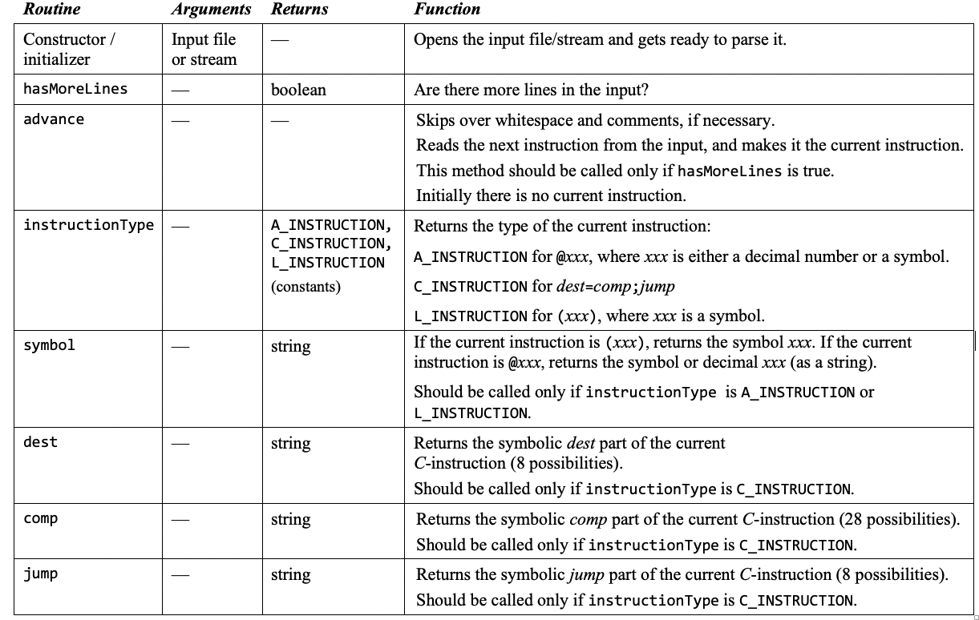
Assembler API (detailed)
Parser module:

Slide 78
Assembler API (detailed)
Code module:
SymbolTable module:
HackAssembler module:
We propose no API; Implement as you see fit.

Slide 79
Chapter 6: Assembler
Overview
Translating instructions
Translating programs
Handling symbols
Assembler architecture
Assembler API
Project 6
Some history

Slide 80
Developing a Hack Assembler
Contract
Develop a program that translates symbolic Hack programs into binary Hack instructions
The source program (input) is supplied as a text file named Prog.asm
The generated code (output) is written into a text file named Prog.hack
Assumption: Prog.asm is error-free
Usage (if the assembler is implemented in Java):
$ java HackAssembler Prog.asm
Staged development plan
Develop a basic assembler that translates programs that have no symbols
Develop an ability to handle symbols
Morph the basic assembler into an assembler that translates any program

Slide 81
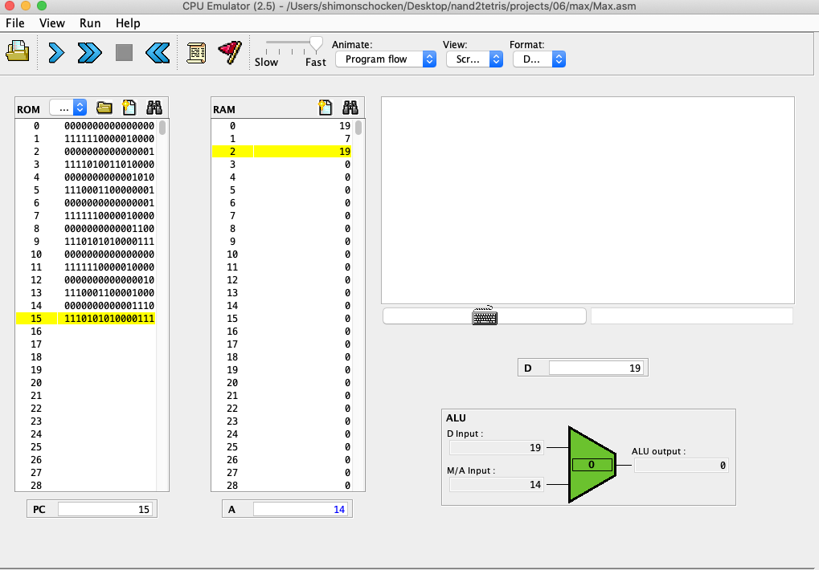
Testing
Prog.asm
Prog.hack
// Computes R1 = 1 + ... + R0
// i = 1
@i
M=1
// sum = 0
@sum
M=0
(LOOP)
// if i > R0 goto STOP
@i
D=M
@R0
D=D-M
@STOP
D;JGT
...
0000000000010000
1110111111001000
0000000000010001
1110101010001000
0000000000010000
1111110000010000
0000000000000000
1111010011010000
0000000000010010
1110001100000001
0000000000010000
1111110000010000
0000000000010001
1111000010001000
0000000000010000
...
Your
assembler
Load /
Run
CPU Emulator
Or use a supplied test script that loads Prog.hack into the CPU emulator and tests it using pre-defined testing scenarios
Test programs
Add.asm
Max.asm
Rect.asm
Pong.asm
MaxL.asm
RectL.asm
PongL.asm
(with symbols)
(same programs, without symbols, for unit-testing the basic assembler)

Slide 82
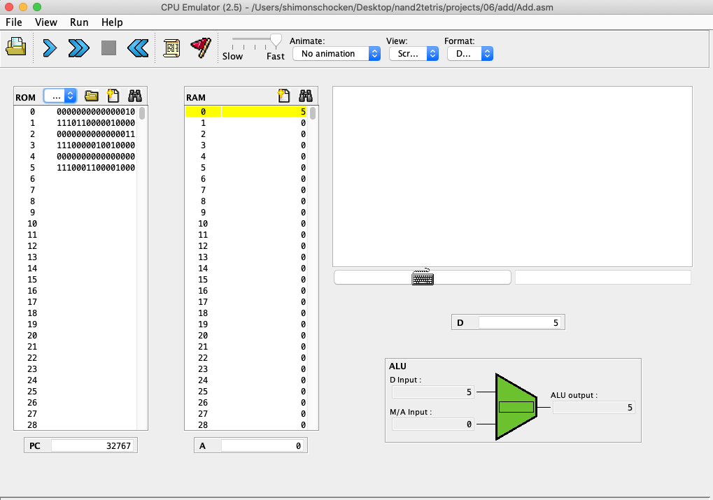
Testing
Add.asm
// Computes RAM[0] =
// 2 + 3
@2
D=A
@3
D=D+A
@0
M=D
Testing on the CPU emulator:
1. Translate Add.asm using your assembler
2. Load the translated Add.hack
3. Run the code, inspect R0.
Note: When loading a binary Prog.hack file into the CPU emulator, the emulator may translate it back to symbolic code (depending on the emulator’s version).
To inspect the binary code, select this option from the ROM menu.

Slide 83
Testing
Max.asm
// Computes RAM[2] =
// max(RAM[0],RAM[1])
@R0
D=M
@R1
D=D-M
@OUTPUT_RAM0
D;JGT
// Output RAM[1]
@R1
D=M
@R2
M=D
@END
0;JMP
(OUTPUT_RAM0)
@R0
D=M
@R2
M=D
(END)
@END
0;JMP
Testing on the CPU emulator:
Translate and load, then:
Put test values in R0 and R1, run the code, inspect R2.

Slide 84
Testing
Max.asm
MaxL.asm
// Computes RAM[2] =
// max(RAM[0],RAM[1])
@R0
D=M
@R1
D=D-M
@OUTPUT_RAM0
D;JGT
// Output RAM[1]
@R1
D=M
@R2
M=D
@END
0;JMP
(OUTPUT_RAM0)
@R0
D=M
@R2
M=D
(END)
@END
0;JMP
// Computes RAM[2] =
// max(RAM[0],RAM[1])
@0
D=M
@1
D=D-M
@12
D;JGT
// Output RAM[1]
@1
D=M
@2
M=D
@16
0;JMP
@0
D=M
@2
M=D
@16
0;JMP
For unit-testing the basic assembler
(Each symbol was replaced with its value)
with symbols
without symbols

Slide 85
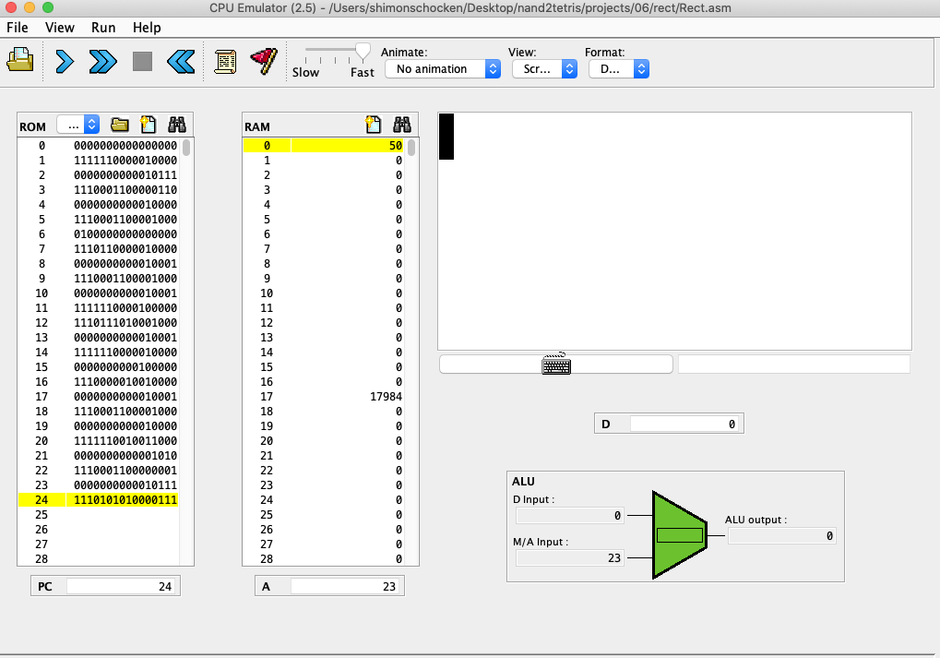
Testing
Rect.asm
// Draws a rectangle.
@R0
D=M
@n
M=D
@i
M=0
@SCREEN
D=A
@address
M=D
(LOOP)
@i
D=M
@n
D=D-M
@END
D;JGT
...
Testing on the CPU emulator:
Translate and load, then:
Put a non-negative value in R0, run the code, inspect the screen.
Draws a rectangle, 16 pixels wide and R0 lines high

Slide 86
Testing
Rect.asm
RectL.asm
// Draws a rectangle.
@R0
D=M
@n
M=D
@i
M=0
@SCREEN
D=A
@address
M=D
(LOOP)
@i
D=M
@n
D=D-M
@END
D;JGT
...
// Draws a rectangle.
@0
D=M
@16
M=D
@17
M=0
@16384
D=A
@18
M=D
(LOOP)
@17
D=M
@16
D=D-M
@27
D;JGT
...
For unit-testing the basic assembler
with symbols
without symbols

Slide 87
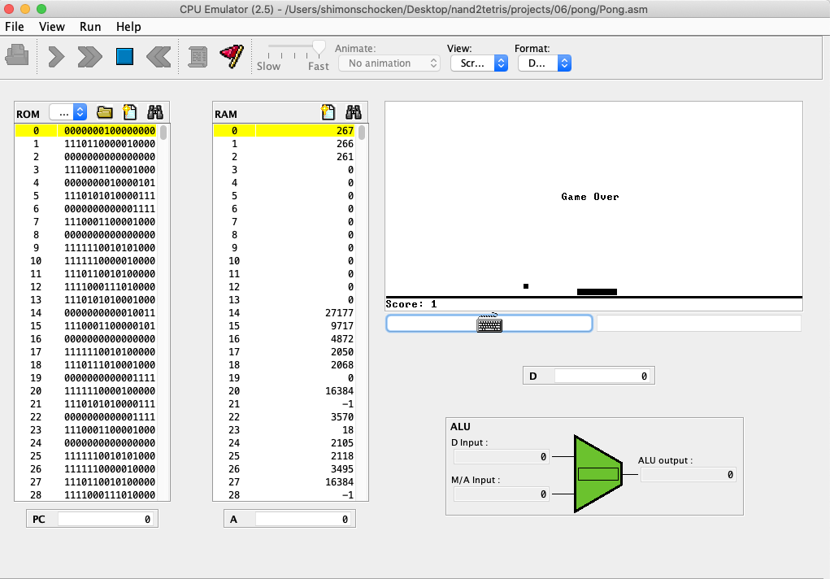
Testing
Pong.asm
// Pong.asm
@256
D=A
@SP
M=D
@133
0;JMP
@R15
M=D
@SP
AM=M-1
D=M
A=A-1
D=M-D
M=0
@END_EQ
D;JNE
@SP
A=M-1
M=-1
(END_EQ)
@R15
A=M
...
Pong game
Translate and load, and then play the game:
Select “no animation”, set the speed slider to “fast”, and run the code. Move the paddle using the left- and right-arrow keys.

Slide 88
Testing
Pong.asm
// Pong.asm
@256
D=A
@SP
M=D
@133
0;JMP
@R15
M=D
@SP
AM=M-1
D=M
A=A-1
D=M-D
M=0
@END_EQ
D;JNE
@SP
A=M-1
M=-1
(END_EQ)
@R15
A=M
...
Background
The original Pong program was written in the high-level Jack language
The computer’s operating system is also written in Jack
The Pong code + the OS code were compiled by the Jack compiler, creating a single Pong.asm file
The compiled code (Pong.asm) has:
No white space, and
Compiler-generated addresses and symbols (which may look strange)
28,374 instructions

Slide 89
Testing option II: Using the hardware simulator
Use your assembler to translate Prog.asm, generating the executable file Prog.hack
Put the Prog.hack file in a folder containing the chips that you developed in project 5: Computer.hdl, CPU.hdl, and Memory.hdl
Load Computer.hdl into the Hardware Simulator
Load Prog.hack into the ROM32K chip-part
Run the clock to execute the program.

Slide 90
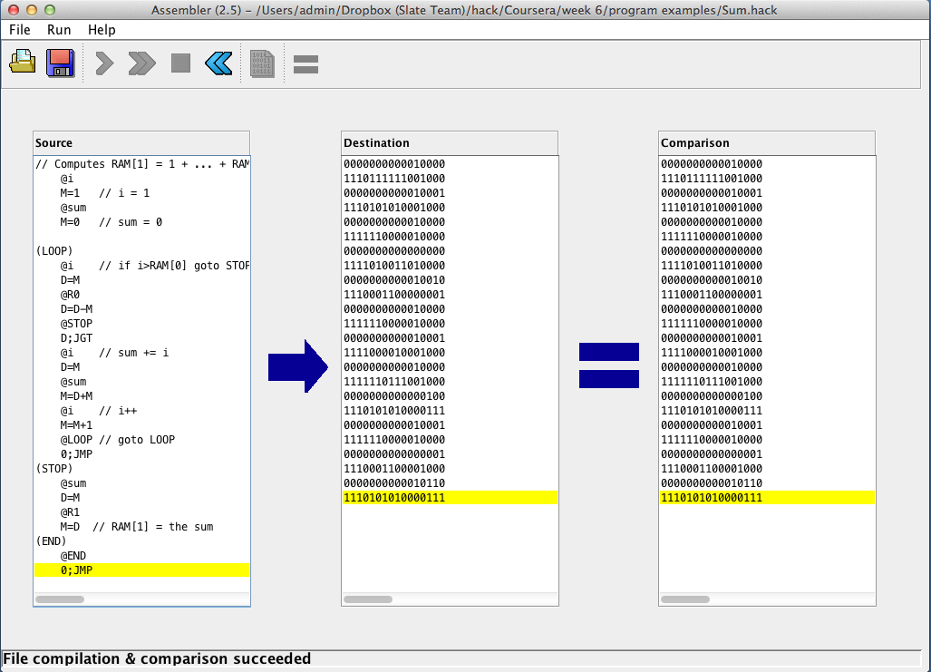
Testing option III: Using the supplied assembler
Prog.hack file, translated by the supplied assembler
Prog.hack file, translated by your assembler
Source Prog.asm test file
Use your assembler to translate Prog.asm, generating the executable file Prog.hack
Load Prog.asm into the supplied assembler, and load Prog.hack as a compare file
Translate Prog.hack, and inspect the comparison feedback messages.

Slide 91
Project 6
Guidelines: www.nand2tetris.org (projects section)
Files: nand2tetris/projects/06 (on your PC)
Tools
The programming language in which you develop your assembler
CPU emulator (for testing the translated programs)
Assembler (if you plan to use it)
Guides
CPU emulator tutorial
Assembler tutorial

Slide 92
Chapter 6: Assembler
Overview
Translating instructions
Translating programs
Handling symbols
Assembler architecture
Assembler API
Project 6
Some history

Slide 93
The Industrial Revolution (1760 – 1840) / Case in Point: Textile
Cotton picking
cleaning
spinning
weaving
Until 1800: labor intensive / slavery / child labor
Industrial revolution: all key processes are mechanized.

Slide 94
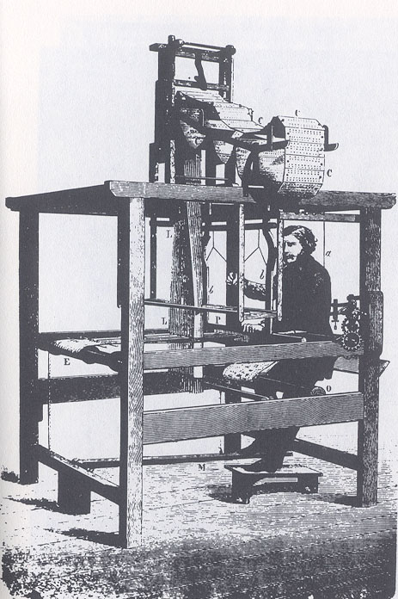
The Industrial Revolution (1760 – 1840) / Case in Point: Textile
Jacquard loom (1801)
The weaving instructions were programmed by punched cards
The cards coded instructions for the loom’s hardware.

Slide 95
The Industrial Revolution (1760 – 1840) / Case in Point: Textile
The weaving instructions were programmed by punched cards
The cards coded instructions for the loom’s hardware.

Slide 96
The Analytic Engine (1837)
An early mechanical computer, designed by Charles Babbage
Designed to tabulate data collected in a UK national census
Featured a simple programming model with conditional branching
Software = punched cards

Slide 97
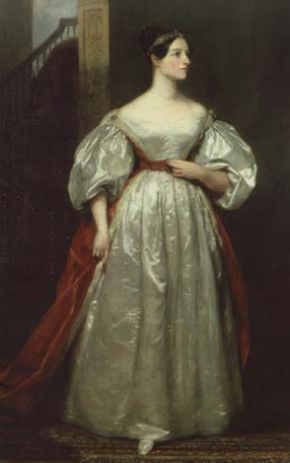
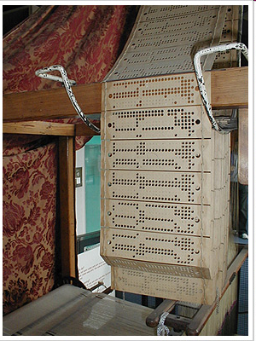
Ada Lovelace (1815 – 1852)
Ada’s insight:
If you want to give a computer instructions, don’t start by punching cards (“binary code”)
Instead, write the instructions on paper, using a symbolic language
When convinced that the symbolic program is error-free, translate it into punched cards.
Ada Augusta King-Noel, Countess of Lovelace
Gifted mathematician and writer
Worked closely with Babbage on the Analytic Engine.

Slide 98
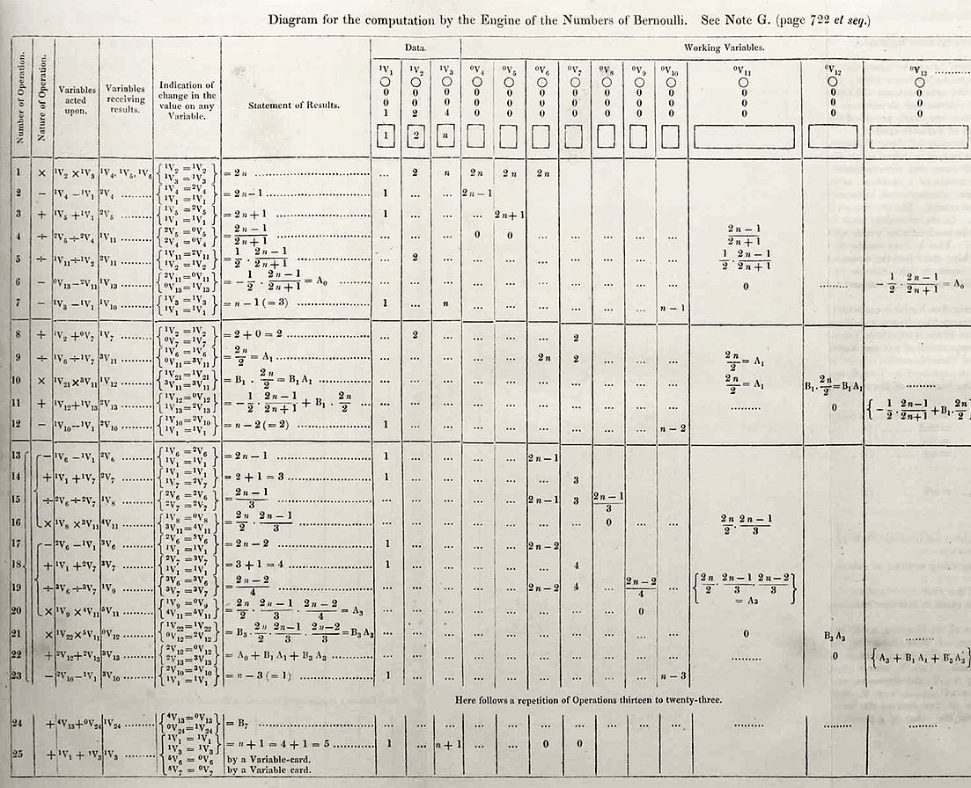
Ada Lovelace (1815 – 1852)
Early program, written by Ada, to compute Bernoulli numbers on the Analytic Engine
Often described as “the first programmer”
The programming language Ada is named after her.

Slide 99
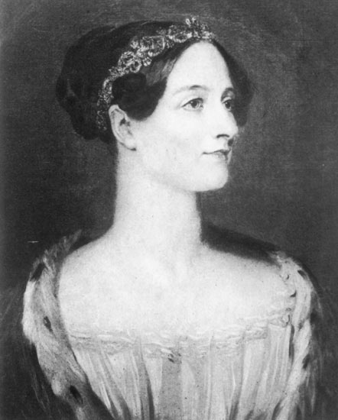
Ada Lovelace (1815 – 1852)
“The Analytical Engine might act upon other things besides numbers...
Suppose, for instance, that the fundamental relations of pitched sounds in the science of harmony and of musical composition were susceptible of such expression and adaptations...
If so, the engine might compose elaborate and scientific pieces of music of any degree of complexity.”
(1840!)

